Slide 2
Therese (b. 1873) Teilhard de Chardin (b. 1881)
Ultramontanist family
The modern narrative
F. Nietzsche – death of
modernity’s god.
Desolation and darkness
Night of faith
In 1934 – “How I believe” spoke of his agonies of doubt. “Our doubts are the price we have to pay for the fulfillment of the universe.”
Phenomenon of Man – written under Japanese occupation in Peking; suffered from depression: one must make a free choice between absolute optimism or absolute pessimism.
1955 – ”Is there a divine milieu? Or am I, after all, simply the dupe of a mirage in my own mind?”

Slide 3
“The fruit of the trial, for Therese was the collapse of her desire for heaven as another world and its replacement by the discovery of heaven as love in the present moment. . . .the discovery that eternal life is now. . . .postmodern philosophers . . .have sought above all the puncturing of the circle of immanence by pointing to an originating. . .destabilizing, differentiating source.”
Mary Froehlich

Slide 4
Therese’s Wager
The darkness of nothingness in the face of belief in the totality of God is the terror of our own forsakenness, the potential meaninglessness of our own lives.
Do our lives have absolute value or not?
Therese made an ‘agential cut,’ a resolution, that in the heart of the Church she would be Love: “Thus, I shall be everything”

Slide 5
Teilhard’s Trust in Matter
Emphasizes a Sense of the Whole
The primacy of material matter, ‘Matter-Matter’ expressed in Mineral and Rock
A sense of plenitude
Contact with the Cosmic in the ‘solid state’
(from The Heart of Matter, p. 21-22).

Slide 6
“If I were to lose my faith in Christ, my faith in a personal God and my faith in spirit, I would continue to believe invincibly in the world. The world, when all is said and done, is the first, the last, and the only thing in which I believe. It is by this faith that I live. And it is to this faith . . . that I shall surrender myself at the moment of death.”
Teilhard de Chardin, Christianity and Evolution

Slide 7
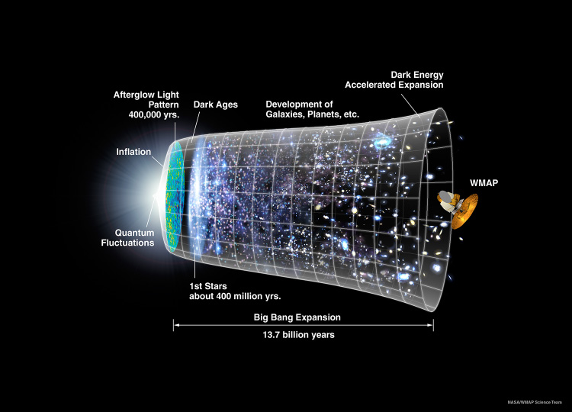
The Hot Big Bang Cosmos
years
13.8 billion
1 billion yrs
Hydrogen 75%
Helium 25%

Slide 8
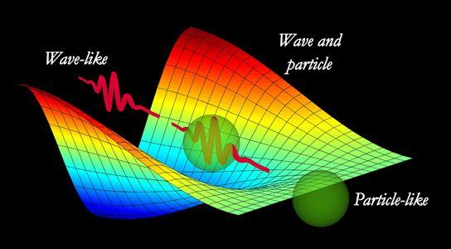
Quantum Reality

Slide 9
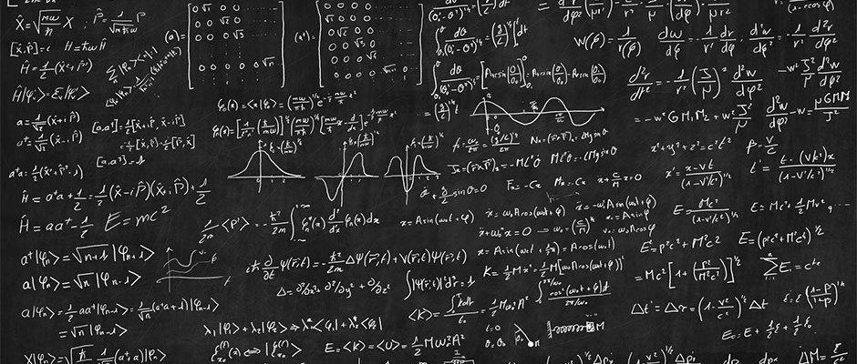
Matter is not what we think it is

Slide 10
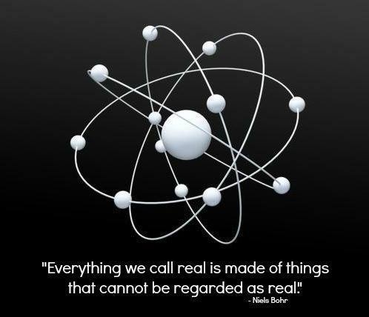

Slide 11
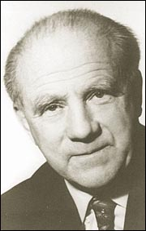
Uncertainty Principle Werner Heisenberg (1901-1976)
"The more precisely the POSITION is determined the less precisely the MOMENTUM is known“
(Heisenberg, Uncertainty paper, 1927)

Slide 12
Implications of Uncertainty Principle
No deterministic universe. Cannot predict future events.
What cannot be measured cannot take place exactly.
No distinction between process of observed and what is observed. No line between subject and object
The "path" comes into existence only when we observe it. The act of observation produces physical reality.
We are actors rather than spectators

Slide 13
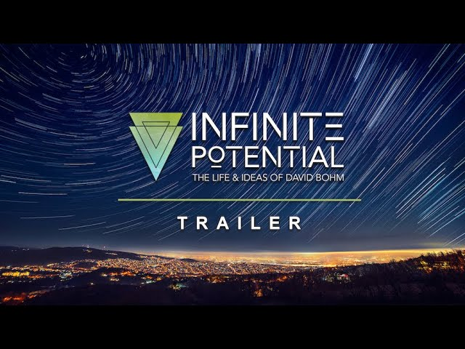
https://www.youtube.com/watch?v=aMx4cfz8Anw

Slide 14
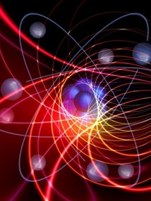
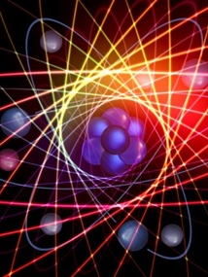
Quantum Entanglement
Take two particles whose spins cancel each other out to zero. Separate particles by distance. If measure particle A as “up” particle B is measured “down.”
The measurement on A does not merely reveal an already established state of B: It actually produces that state ➔ entangled.
“Non-local action at a distance”
“Those who fire together wire together”

Slide 15
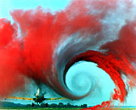
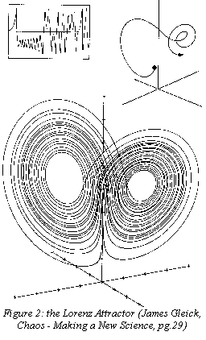
CHAOS THEORY
Turbulence in the tip vortex
from an airplane wing.

Slide 16
13.8 billion
1 billion yrs
Mind
Matter

Slide 17
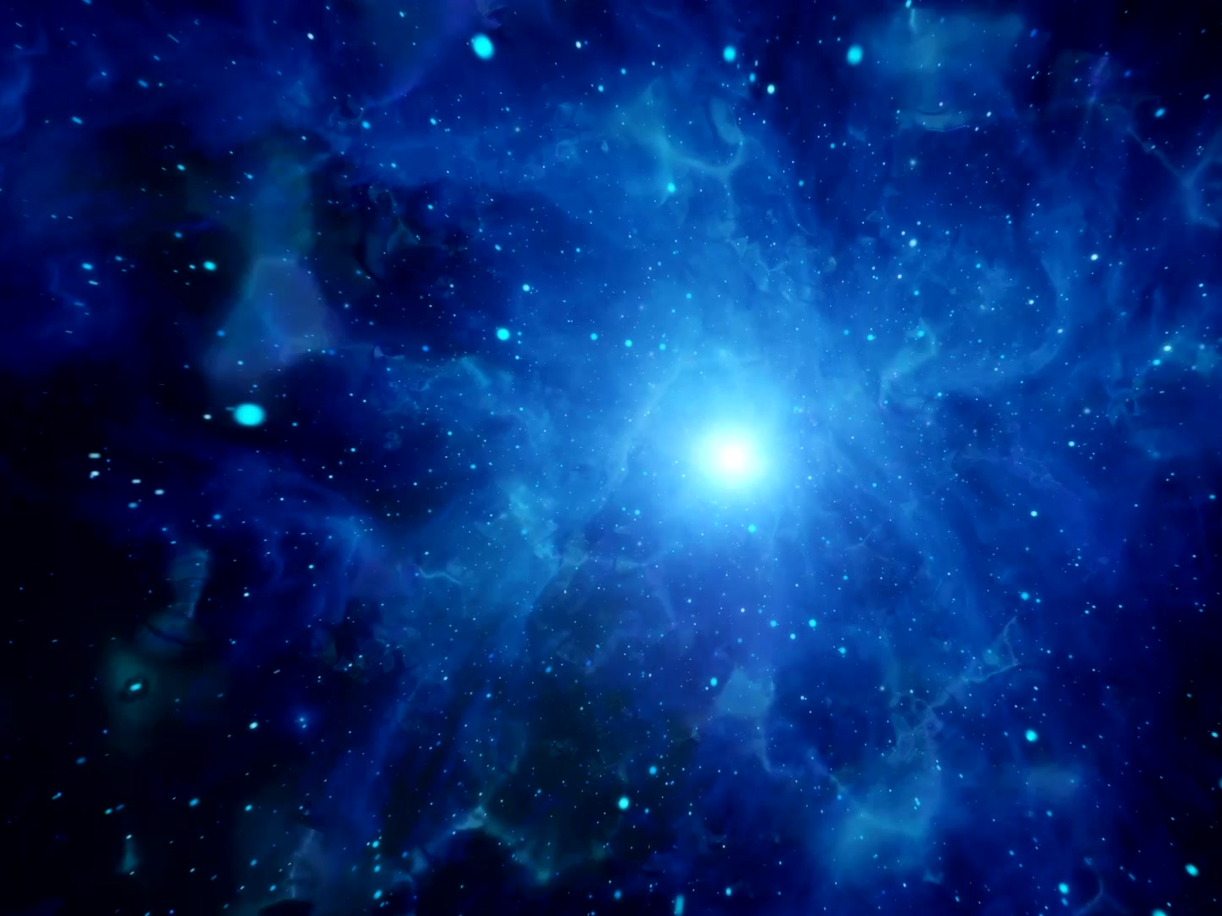
Panpsychism
Consciousness is a fundamental quality of the cosmos, as fundamental as space, time and matter, or even more so, undergirding these properties.
Consciousness, in a sense, precedes or grounds material forms; everything has consciousness; the mental occurs down to the lowest level of the physical world.

Slide 18
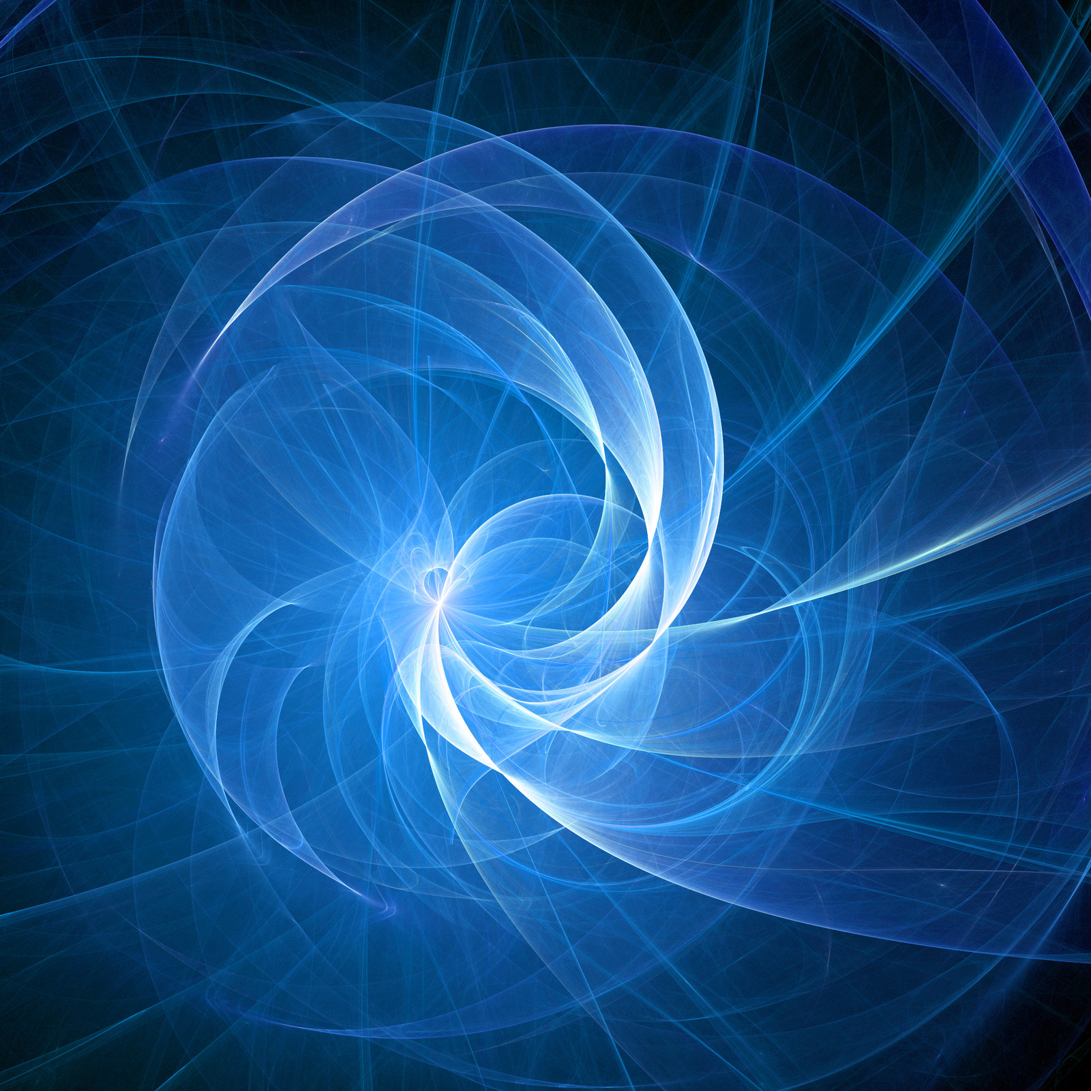
Quantum Reality
“Nature is not composed of material substances
but deeply entangled fields of energy;
the nature of the universe
is undivided wholeness.

Slide 19
Teilhard’s Two Energies
Consciousness
Within
Attraction
Without
Attraction
Without
Radial energy = transcendence
Tangential Energy = attraction

Slide 20
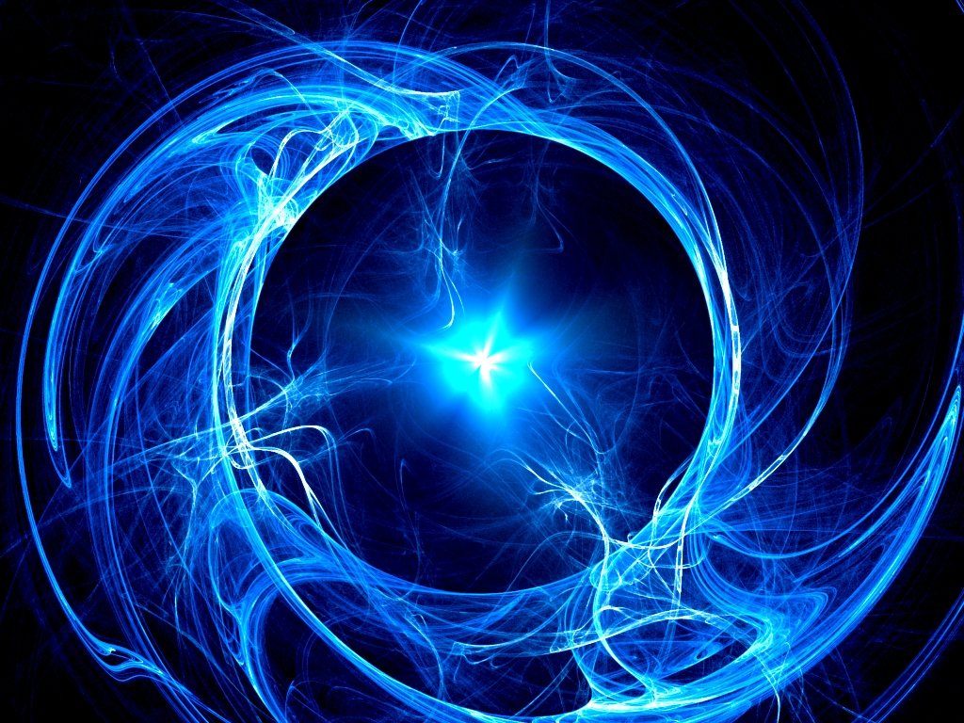
Scientific
Religious
Omega
The Whole of the Whole

Slide 21
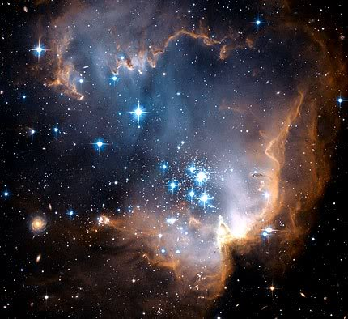
Nothing holds together absolutely expect through the Whole; and the Whole itself holds together only through this its future fulfilment.
“The universe is organically
resting on the future as its sole support.”
OMEGA

Slide 22

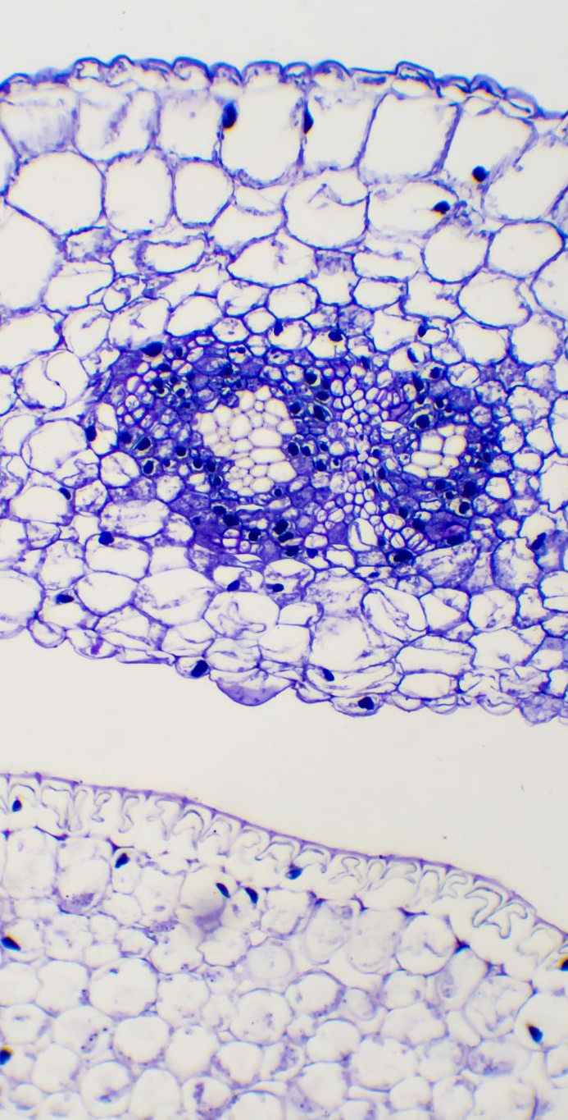
Omega is associated with the energy of love and accounts for the “more in the cell than in the molecule, more in society than in the individual, and more in mathematical construction than in calculations or theorems.”
Omega is brought into the field of consciousness as it emerges from the organic totality of evolution; it is the form and goal toward which evolution tends.

Slide 23
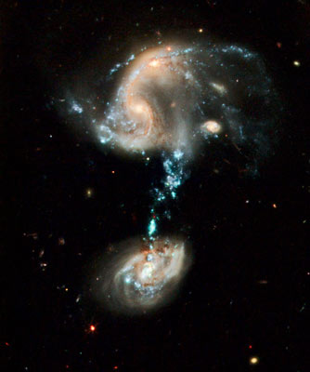

“Love is the most universal,
the most tremendous and
the most mysterious of the cosmic forces. .
Teilihard de Chardin

Slide 24
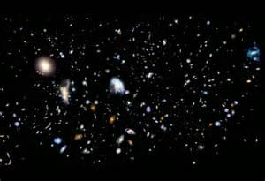
Toward more consciousness
“Driven by the forces of love,
the fragments of the world
are seeking each other,
so that the world
may come into being.”
Teilhard de Chardin
Human Energy

Slide 25
“The physical structure
of the universe
is love.”
Teilhard de Chardin
Human Energy

Slide 26
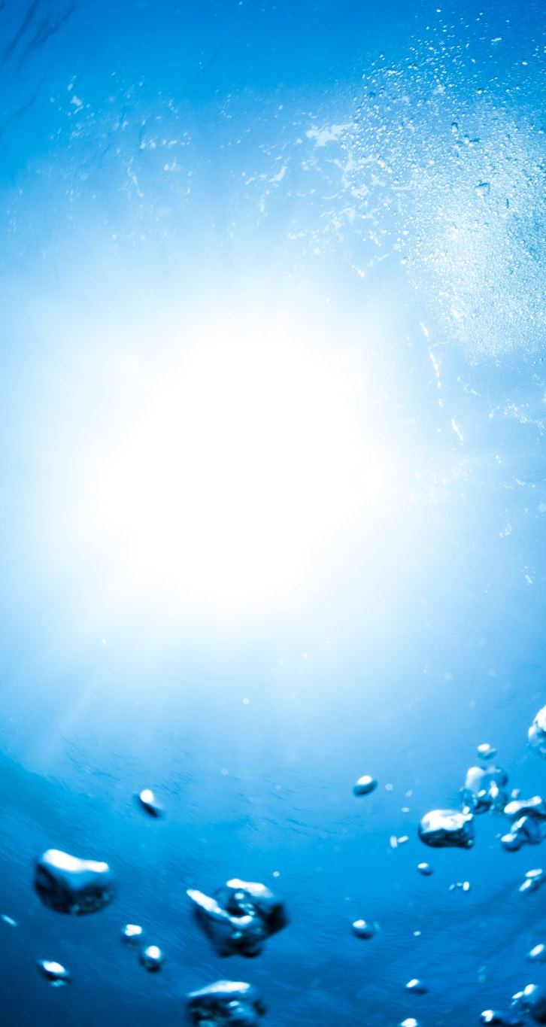
“There gradually grew in me, as a presence much more than an abstract notion, the consciousness of a deep-running, ontological, total current which embraced the whole universe in which I moved; and this consciousness continued to grow until it filled the whole horizon of my inner being.”
This presence became symbolized by Omega, a new and vital presence of God, not a God draping the world with power, but a God integral to the world’s becoming.
(The Heart of Matter, 25.)
Omega = God

Slide 27
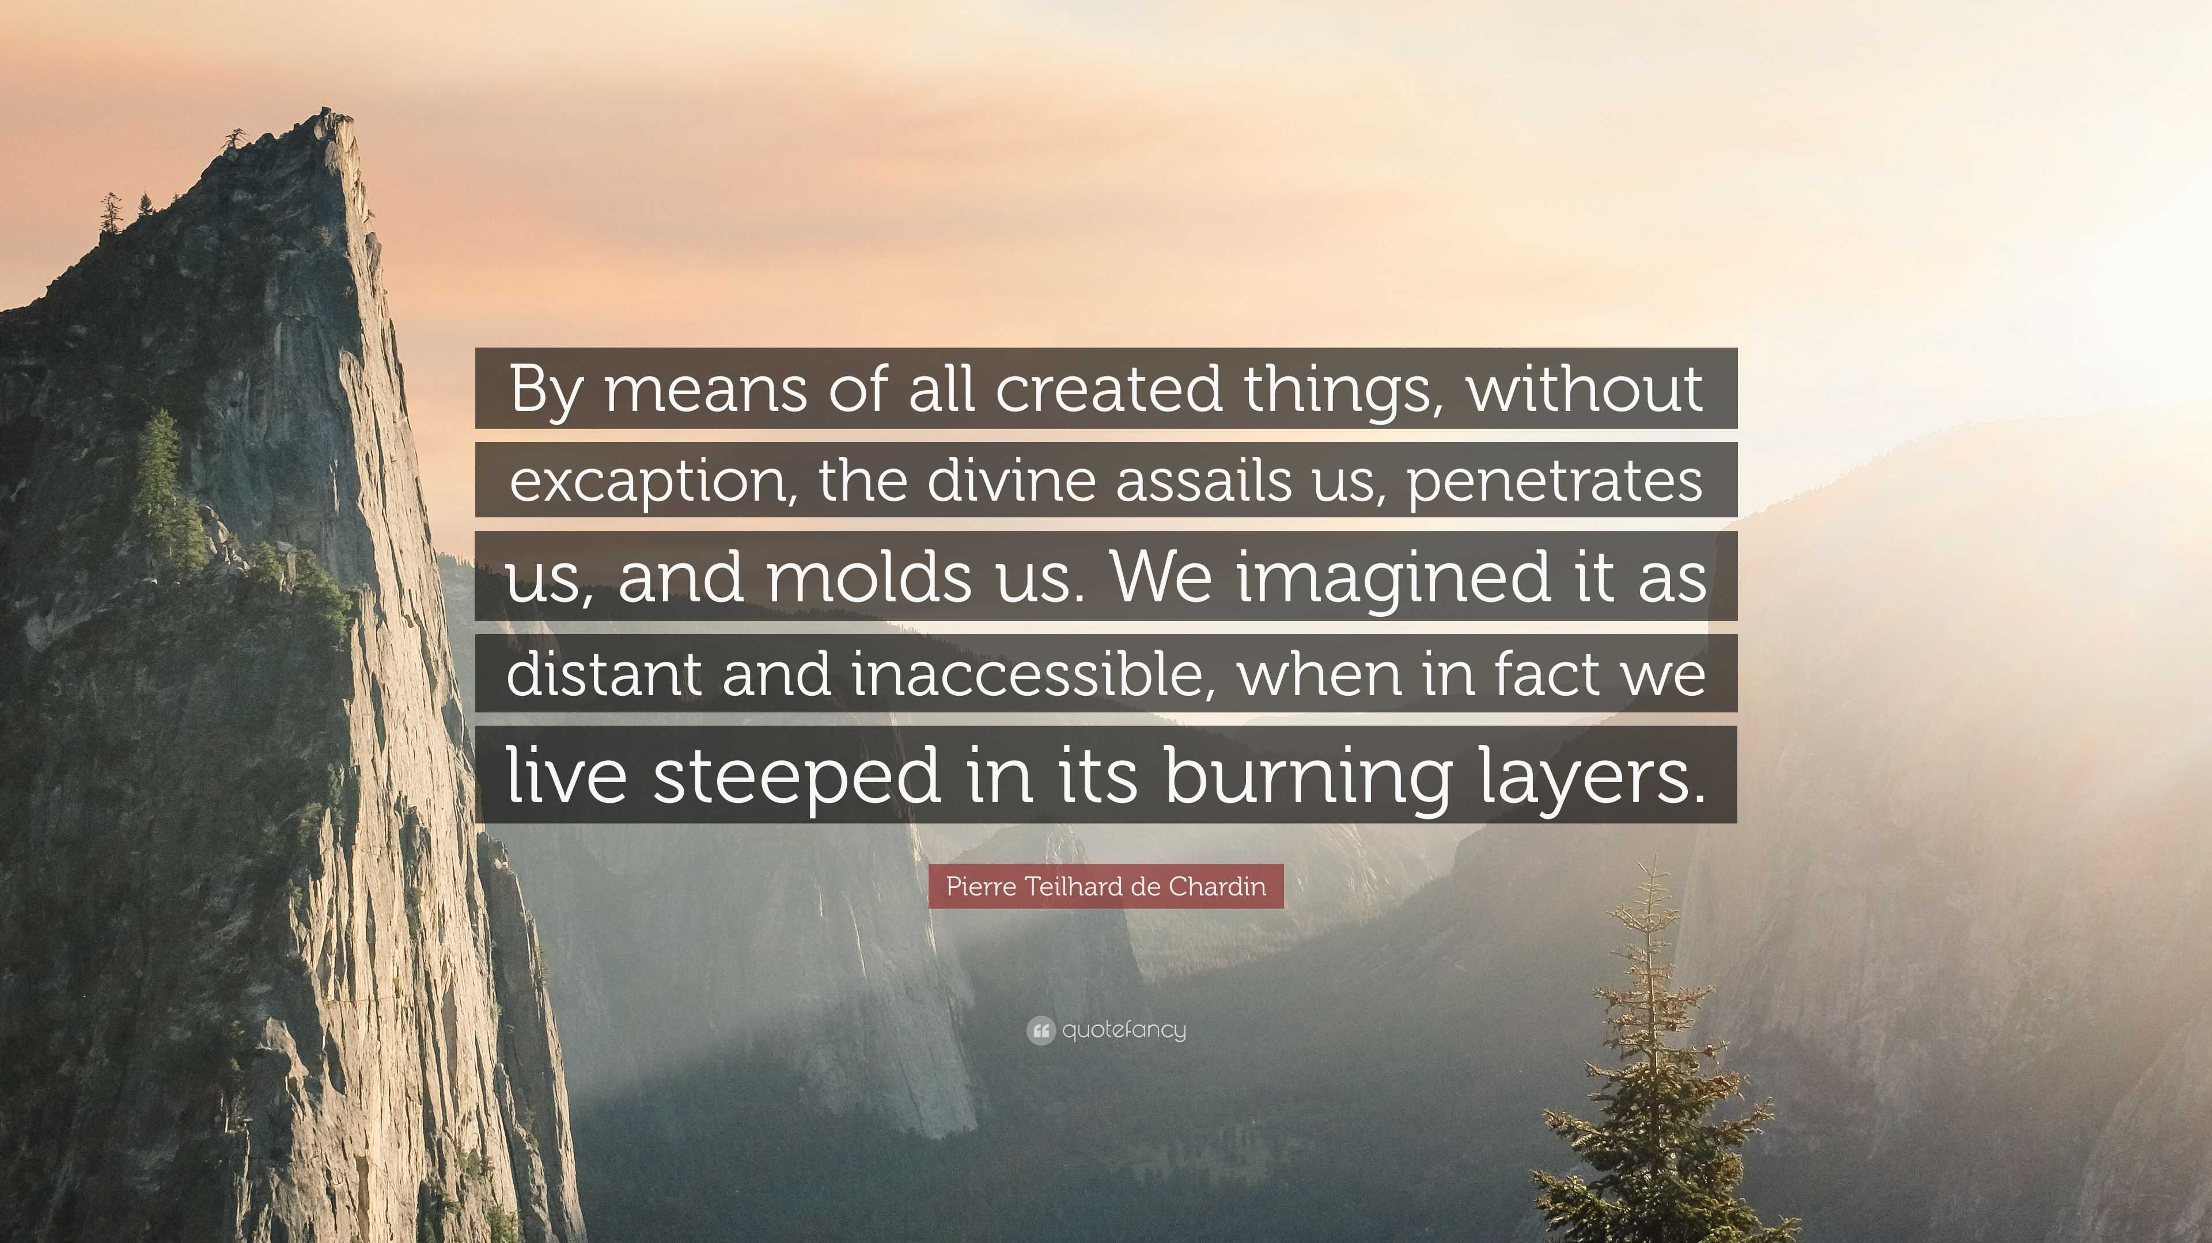

The Divine Milieu

Slide 28

Without matter we would remain ignorant both of ourselves and of God
I bless you, matter. . .in your totality and your true nature. You I acclaim as the inexhaustible potentiality for existence and transformation. . .I acclaim you as the universal power which brings together and unites. . .I acclaim you as the divine milieu, charged with creative power. . .Raise me up then, matter. . .until, at long last, it becomes possible for me in perfect chastity to embrace the universe.
(Hymn of the Universe, 69)

Slide 29
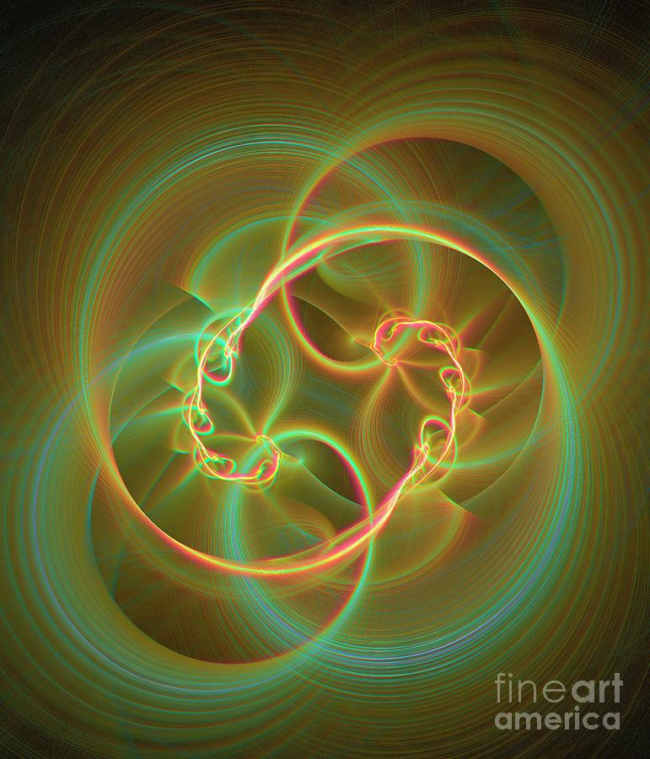
GODWORLD Entanglement

Slide 30
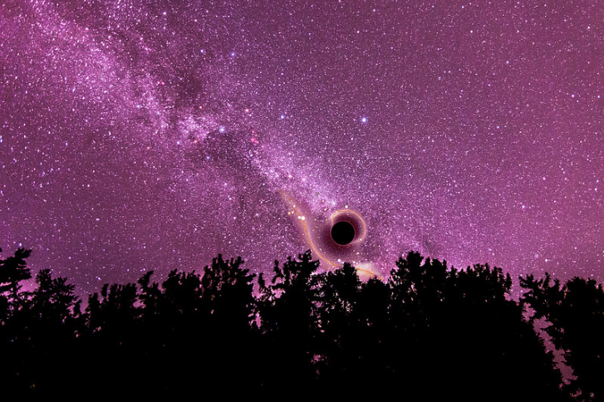
“God and World form a complementary whole.”
Teilhard de Chardin

Slide 31
God and world are in the process of becoming something more together because the universe is grounded in a center of divine love.
God is the name of absolute wholeness in love.
The evolution of God and the evolution of humanity cannot be separated.
“There is only one real evolution, the evolution of convergence, because it alone is positive and creative.”
Christianity and Evolution, 87

Slide 32
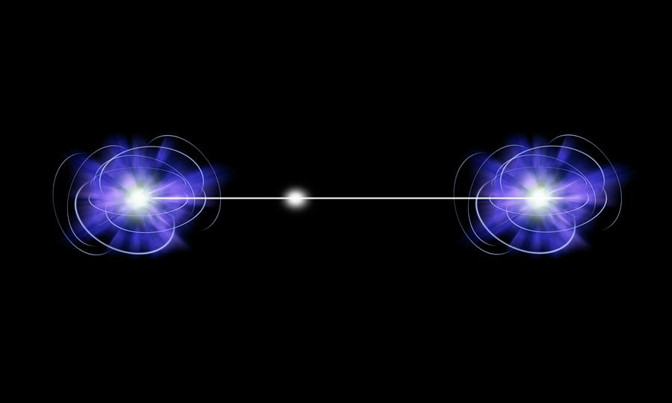
We live in an entangled universe of inseparability where everything is connected to everything else, including God.
Teilhard writes: “I see in the world a mysterious product of completion and fulfillment for the Absolute Being himself.” (Heart of Matter, 54)

Slide 33
“At a time when the consciousness of its own powers and possibilities is awakening in a humankind now ready to become adult, one of the first duties of a Christian is to show that the incarnate God did not come to diminish in us the glorious responsibility and splendid ambition that is ours:
of fashioning our own self.”
Teilhard de Chardin

Slide 34
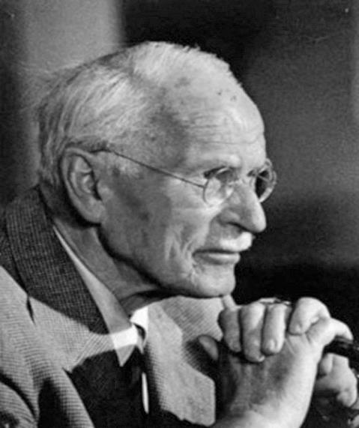
Theology After Jung (d. 1961)
The many gods become one
The one God becomes human
Every human is to become God.
Religion is a natural process of individuation
Individuation is integral to God’s becoming

Slide 35
Religion is a natural process of individuation.
Humanity’s relation to divinity lay in its relation to the unconscious (cosmic plenum) as the ground of consciousness and meaning.

Slide 36
Jung and Teilhard
God needs humankind to become both whole and complete; there is an openness of God to pleroma.
God and humanity form a complementary pair-- an entangled whole--and the individuation of each is inextricably bound with the other.
The dynamism of God and the evolution of the cosmos cannot be separated.

Slide 37

Theo-genesis
“God-birthing”
Through ongoing incarnation, God rises up through consciousness and is completed by humankind in directed evolution (Boehme, Hegel, Schelling, Jung).

Slide 38
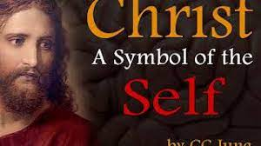

Slide 39
Christ as Archetype
With Jesus emerges a new structure of existence; a new consciousness.
In Jesus we find the Hebraic ethically responsible individual and the intense experience of God’s immediacy.
Faith in God liberates individual to accept the full implications of one’s freedom and responsibility.

Slide 40
Consciousness and the Evolution of God
Consciousness is brought into unconscious darkness in a self-transformative process, one of individuating and becoming whole.
Through ongoing incarnation, God becomes conscious and is completed by humankind in directed evolution. “Theo-genesis”
It is as an archetypal and cosmic reality.

Slide 41
Towards personhood
The “I” is God’s creative activity.
It is God’s acting, God’s loving,
in the present moment –
The “I” is the “Now” of
God’s creative love.

Slide 42
Teilhard de Chardin, Divine Milieu
In each one of us, through matter, the whole history of the world is in part reflected.
God loves and saves the world in and through each soul which is is inseparable from the universe into which it is born.
Everyone must build the soul into a work of great love – this is the completion of the world
We complete Christ by the humble work of our hands, in whatever we do. With each one of our works, we labor to build the Pleroma – ‘we bring to Christ a little fulfillment.’

Slide 43
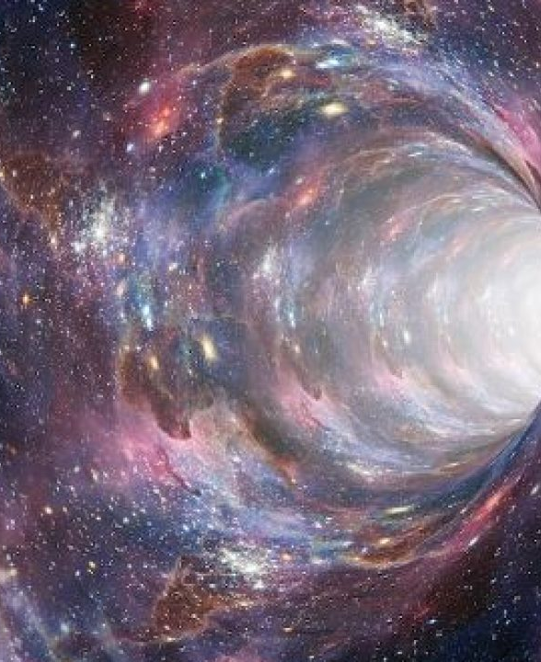
The human person is vitally related to the formation of the dynamic universe.
Contemplation is the process whereby human energy expands and consciousness is maximized.

Slide 44
Consciousness and Contemplation
“The more conscious the individual becomes,
the more individual becomes person
(that is, relational, connected),
and each person is person
only to the extent that the individual
freely lives
by the life of the Whole.”
Beatrice Bruteau

Slide 45

Contemplation
maximizes
Consciousness

Slide 46
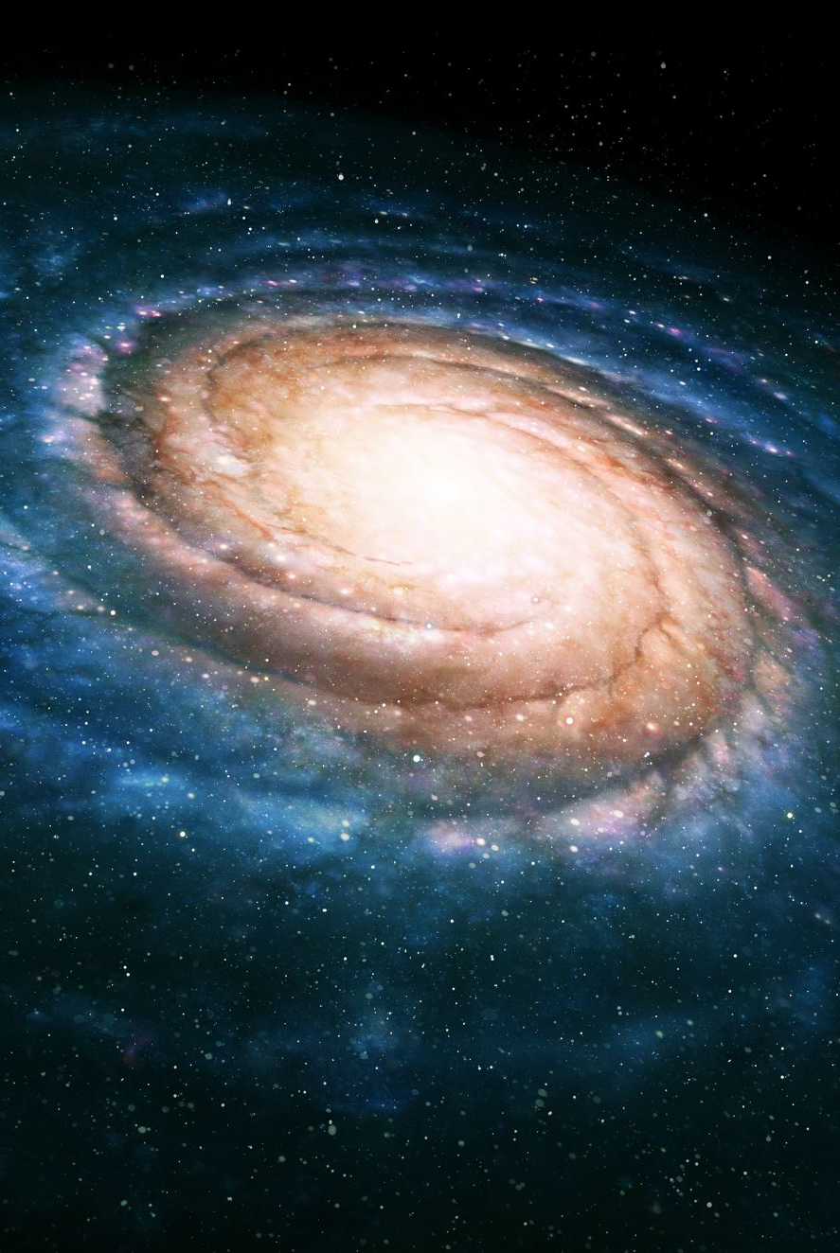
Only inner transformation
can escape cosmic entropy
and thus centrate energy
on higher levels
of complexity.

Slide 47
Contemplation: Human Energetics
Contemplation and action are structurally related components of the rise of human energy.
The contemplative is one in whom the sap of the world, the energy of matter, flows; the one who embodies a zest for life.

Slide 48
God’s Life is Our Life
God is inviting us to build our selves, one another, and the whole earth for eternity.
What happens in time to and through us does not disappear into a past but is preserved in God.
We make a difference to the eternal God.

Slide 49
The human person is vitally related to the ongoing formation of the dynamic universe.
Evolution continues through us, our choices and actions.

Slide 50
“In action, I adhere to the creative power of God; I coincide with it. I become not only its instrument but its living extension. I merge myself through my heart with the very heart of God. It is continuous because I am always acting.
I am always becoming more myself and more God.”
“There is a sense in which God is at the tip of my pen, my spade, my brush, my needle—of my heart and of my thought. By pressing the stroke, the line, or the stitch, on which I am engaged, to its ultimate natural finish, I shall lay hold of that last end towards which my innermost will tends.”
Teilhard de Chardin, The Divine milieu

Slide 52
Creative union - we united with God in the shared love of the end for which we are working
Whatever our role may be – God is inexhaustibly attainable in the totality of our action.
This is the knitting together of God and world.

Slide 53
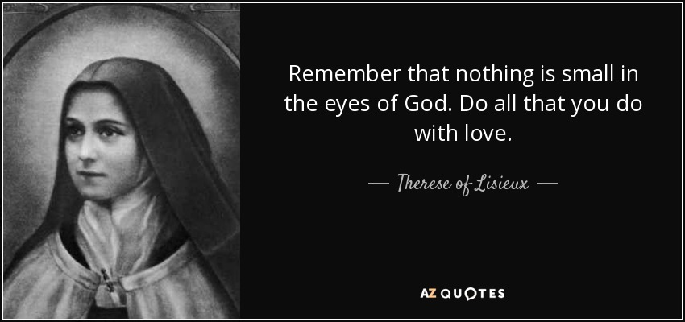

Slide 54
THERESE’S THEOGENESIS
Childlike Trust and Abandonment to God
Small Acts of Love
Doing Ordinary Things with Extraordinary Love
Acceptance of Imperfections
Humility and Simplicity
Complete Dependence on God

Slide 55
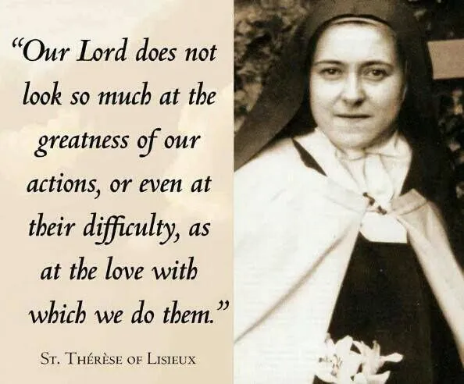

Slide 56
We are the rising up of God in evolution.
When our minds and hearts expand in love, God is born in us and through us into the universe; the world moves ever closer toward Omega.

Slide 57
“Far from escaping
the evolutionary structures
of the world,
the mystic
refines those structures.”
Martin Laird

Slide 58
Zest for Life
Cosmic energy
Human Energy
Contemplative energy

Slide 59
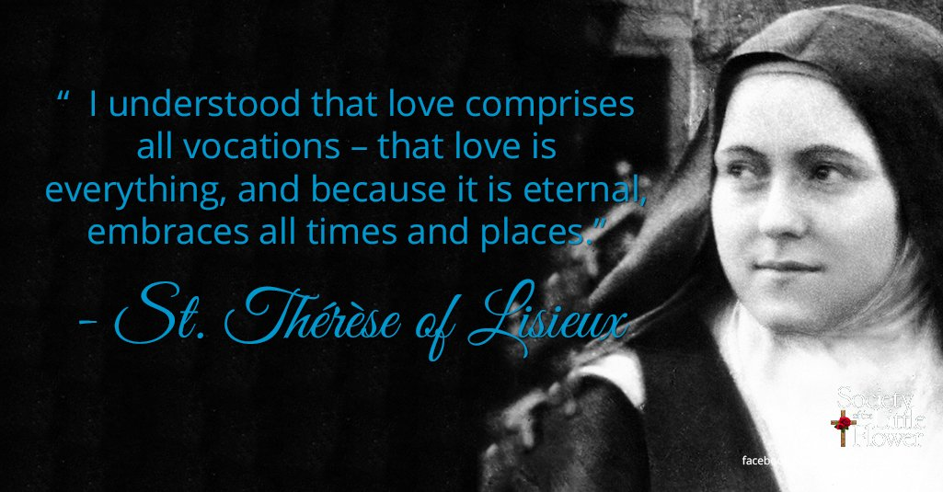

Slide 60
The darkness of love is the emergence of light
Christianity is in fact a soul of immense power which bestows significance and beauty and a new lightness on what we are already doing.
“To create or organize material energy brings with it an inner torment. An honest workman not only surrenders his calm and peace but must learn continually to jettison the form which his art or thought first took and go in search of new forms.”
To pause or to bask in or possess results would be a betrayal of action.
Teilhard de Chardin, The Divine milieu

Slide 61
Teilhard’s Epekstasis
One must go beyond oneself, tear oneself away from oneself, leaving behind what she has attained. . . each reality attained and left behind gives us access to the discovery and pursuit of an ideal of higher [spiritual] content.
Gradually the work no longer belongs to oneself. Little by little the great breadth of the universe has entered into the fissure of one’s humble but faithful actions, has broadened her, raised her up and borne her on.
Teilhard de Chardin, The Divine milieu

Slide 63
“Each of us moves things along
in the direction of war
every time we fail
in love.”
Etty Hillesum

Slide 64
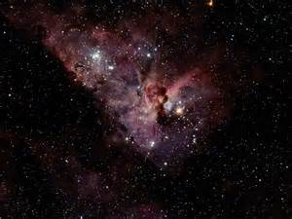
What you are in love with,
what seizes your imagination,
will affect everything.
Fall in Love, stay in love,
and it will decide everything.
Pedro Arrupe, S.J.

Slide 65
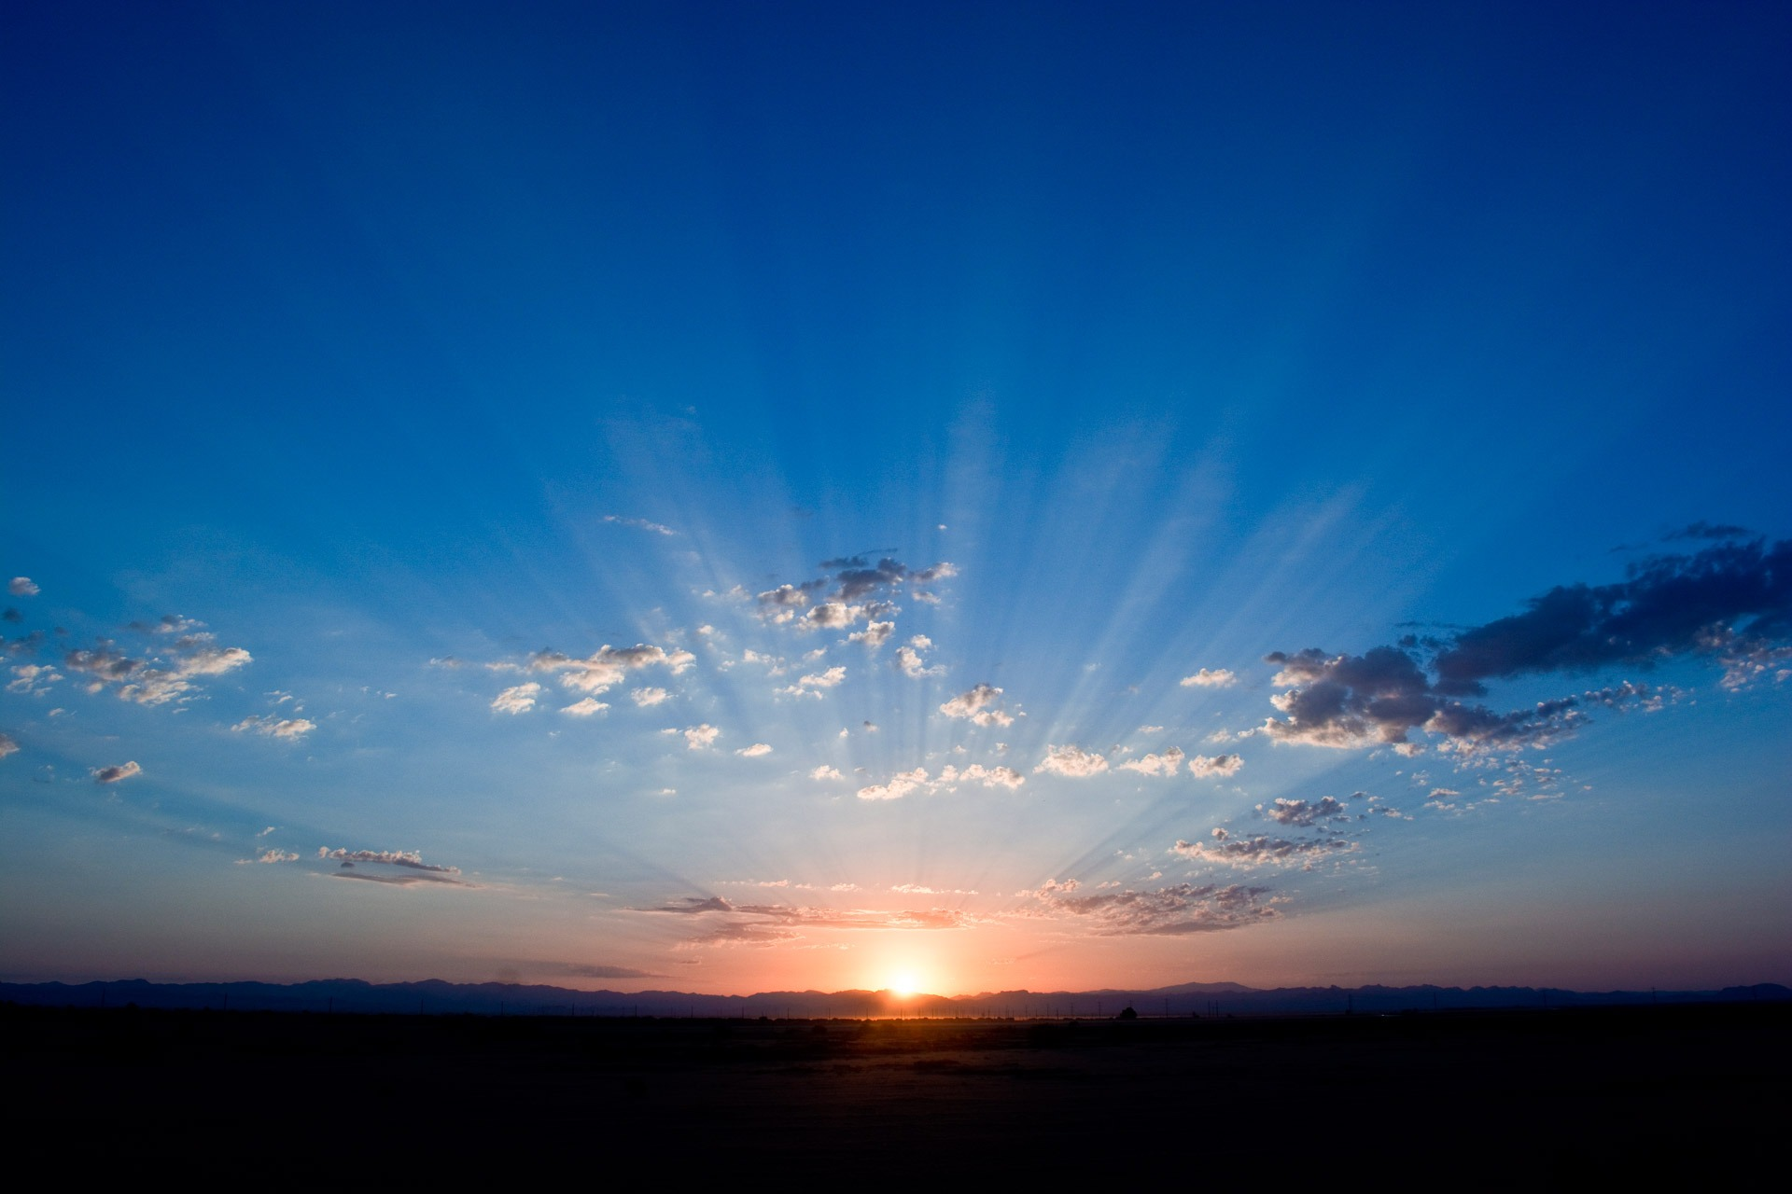
Love alone can bring us to the threshold of another universe.
Teilhard de Chardin

Slide 66

